Slide 1


PIZZA
SALES
REPORT
Presented By:- Sourav Dutta

Slide 2

Welcome to Pizza Sales Analysis Project. The Pizza Business is growing, but to continue this success we need to understand the sales data in depth. This projects explores critical aspects of operations, such as total orders, revenue, pizza types, and customer behavior. By answering basic, Intermediate and advance level questions the goal is to uncover insights that can guide business strategies.
Introduction

Slide 3
Questions
Retrieve the total number of orders placed.
Calculate the total revenue generated from pizza sales.
Identify the highest-priced pizza.
Identify the most common pizza size ordered.
List the top 5 most ordered pizza types along with their quantities.
Join the necessary tables to find the total quantity of each pizza category ordered.
Determine the distribution of orders by hour of the day.
Join relevant tables to find the category-wise distribution of pizzas.
Group the orders by date and calculate the average number of pizzas ordered per day.
Determine the top 3 most ordered pizza types based on revenue.
Calculate the percentage contribution of each pizza type to total revenue.
Analyze the cumulative revenue generated over time.
Determine the top 3 most ordered pizza types based on revenue for each pizza category.

Slide 4
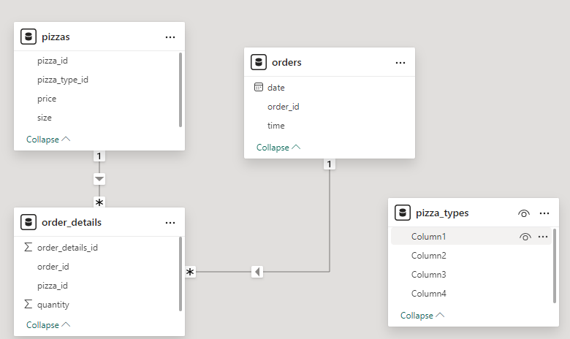
SCHEMA

Slide 5
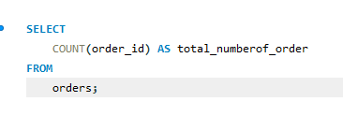

Retrieve the total number of orders placed.

Slide 6
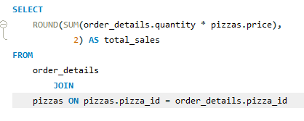

Calculate the total revenue generated from pizza sales..

Slide 7
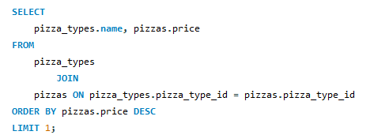

Identify the highest-priced pizza.

Slide 8
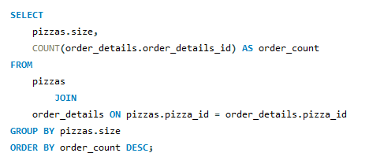
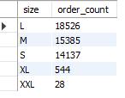
Identify the most common pizza size ordered.

Slide 9
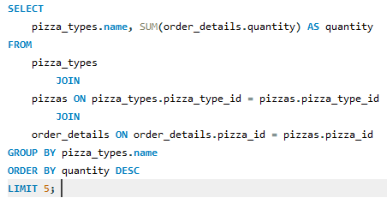
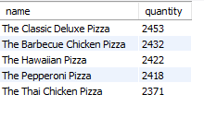
List the top 5 most ordered pizza types along with their quantities.

Slide 10
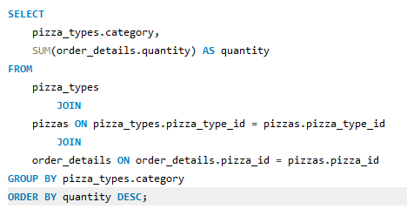
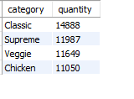
Join the necessary tables to find the total quantity of each pizza category ordered

Slide 11
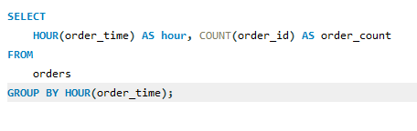
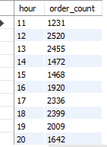
Determine the distribution of orders by hour of the day

Slide 12
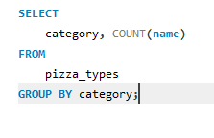
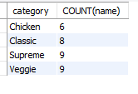
Join relevant tables to find the category-wise distribution of pizzas

Slide 13
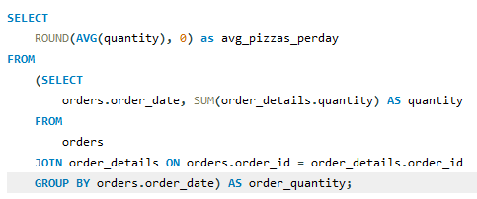

Group the orders by date and calculate the average number of pizzas ordered per day

Slide 14
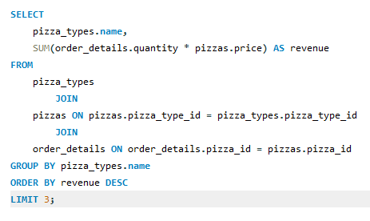

Determine the top 3 most ordered pizza types based on revenue

Slide 15
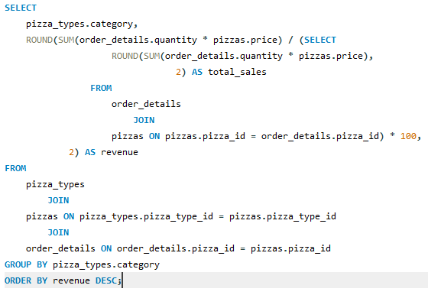
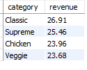
Calculate the percentage contribution of each pizza type to total revenue

Slide 16
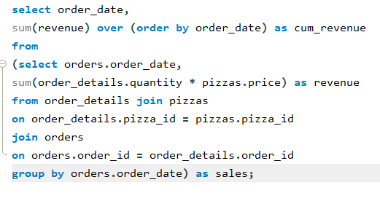
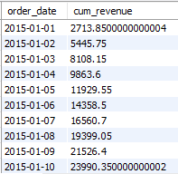
Analyze the cumulative revenue generated over time

Slide 17
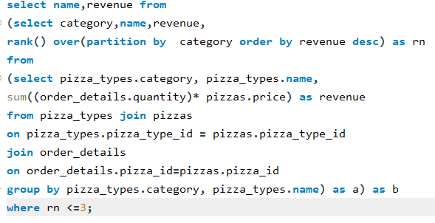
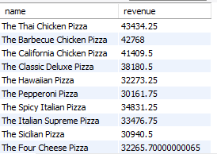
Determine the top 3 most ordered pizza types based on revenue for each pizza category

Slide 18
CONCLUSION
In summary, the Pizza Sales Analysis project leveraging MySQL demonstrates the critical role of data-driven decision-making in optimizing business operations. By thoroughly analyzing customer preferences, sales trends, and profitability metrics, the project uncovers actionable insights to refine marketing strategies, enhance product offerings, and boost customer satisfaction. Through data import, cleaning, analysis, and visualization, this project highlights proficiency in MySQL data analysis techniques. The recommendations from this analysis provide valuable guidance for improving sales performance and achieving overall business success. Ultimately, this project emphasizes the significance of data analytics in driving informed decisions and gaining a competitive edge in the pizza industry.

Slide 19
Thank You
26 June, 2024

